Slide 1
Estimating Ethereum Gas Prices
Brandon Butler
DSI Capstone October 2017

Slide 2

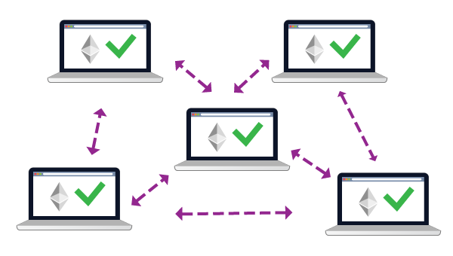
Notes:
What is block chain? A distributed (decentralized) data platform for managing electronic cash without a central administrator among people who know nothing about one another
Bitcoin has been around for a while now and was the first implementation of blockchain tech. Ethereum is the next generation of blockchain technology
smart contract: A smart contract is a computerized transaction protocol that executes the terms of a contrat https://urbancrypto.com/ethereum-blockchain/
add a little more on what blockchain is

Slide 3
Ethereum gas
Computational effort required to process transaction
Gas price:
A set price to pay per unit of gas spent
Total Fee = Gas Price X Gas Used
– Set gas price too low
– Set gas price too high
Transaction fails
Overpaid

Slide 4
Collect data from Ethereum API
Transaction level
Block level
Engineer features based on hindsight
Gas price recommendation

Slide 5
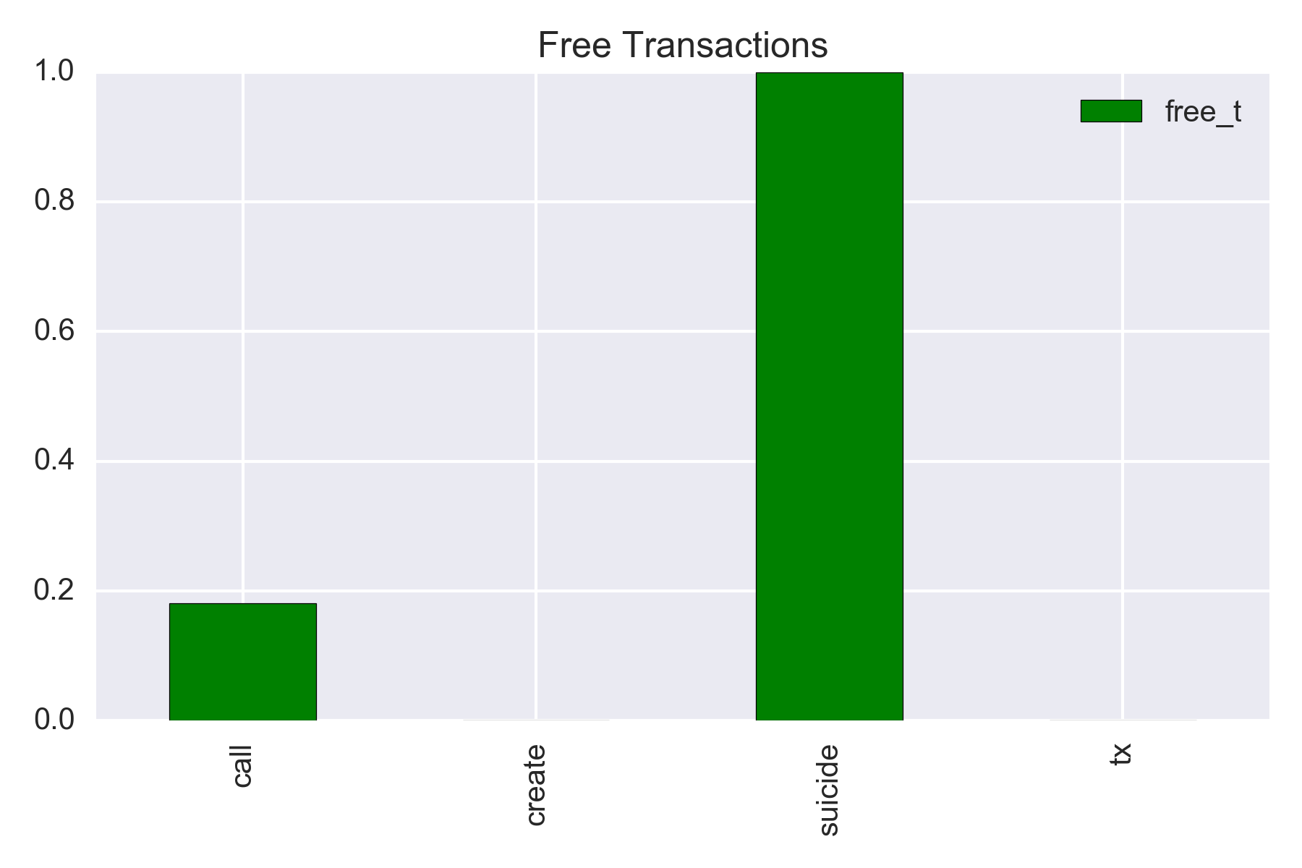
Transactions
– Monetary transfers: tx
– Smart contracts: calls, create, suicide
Free transactions
– All suicides are free
– Calls are free ~20% of the time
– Create/tx always use gas
Notes:
- make less confusing

Slide 6
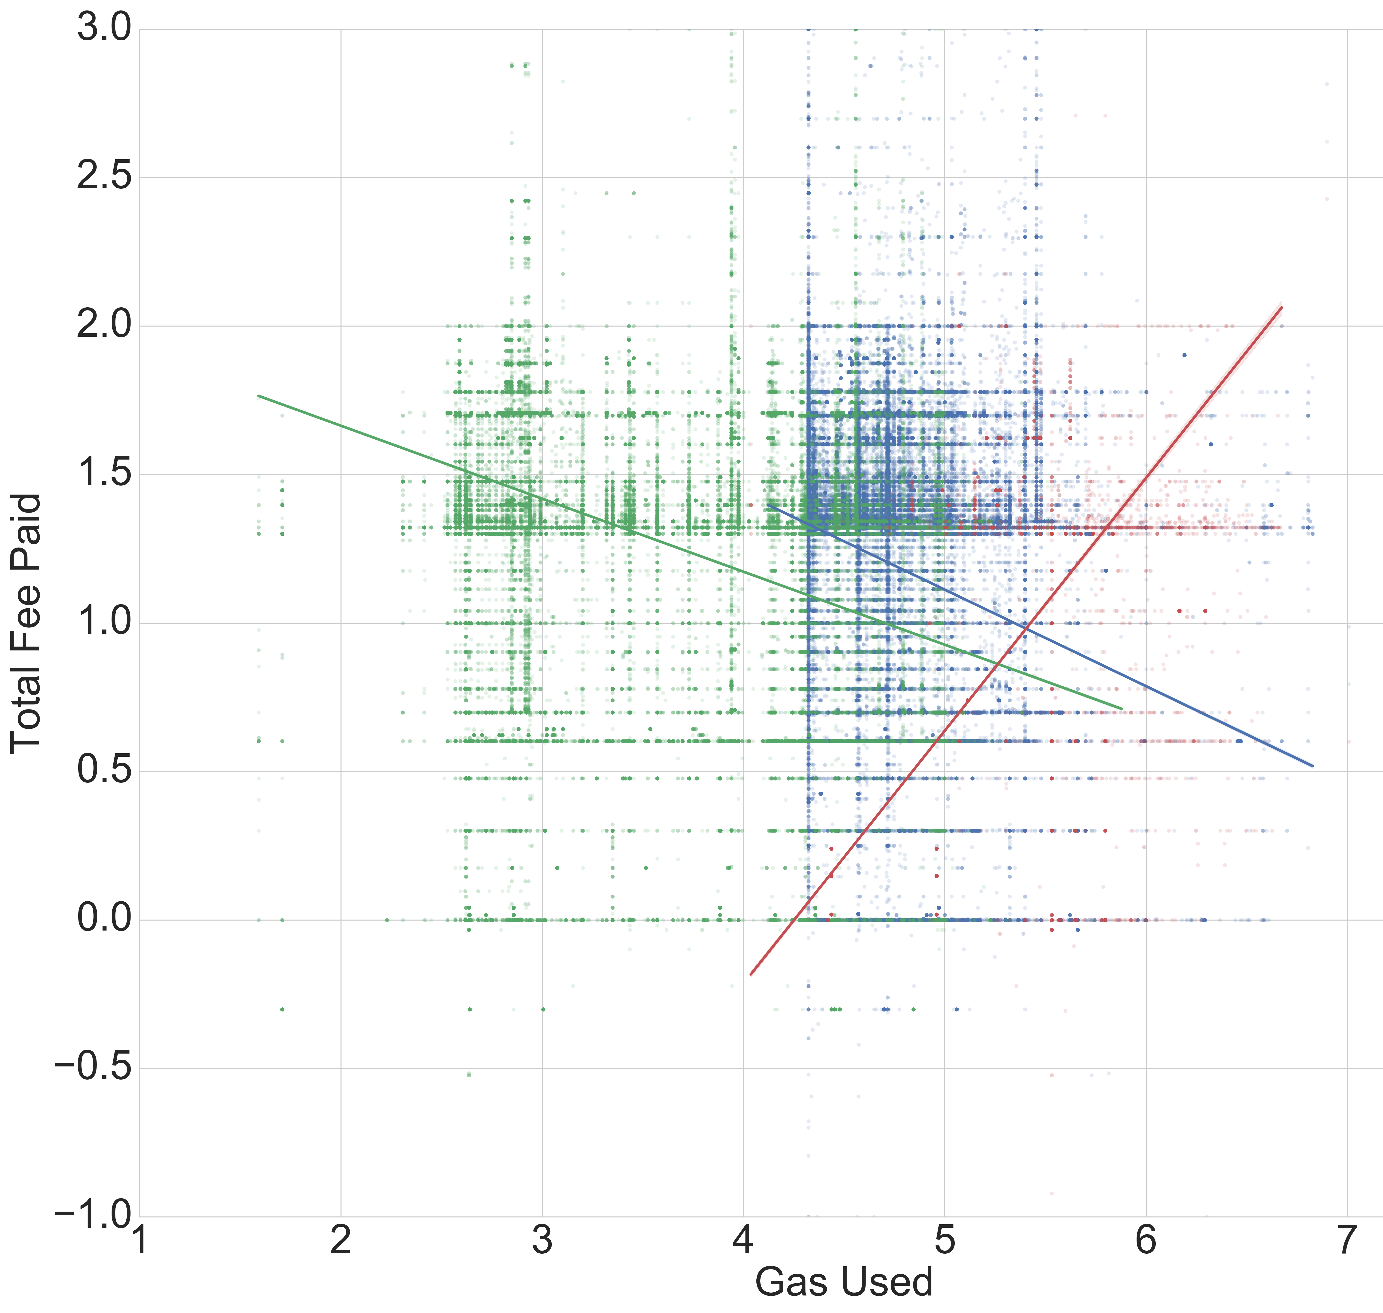
Notes:
- make labels

Slide 7
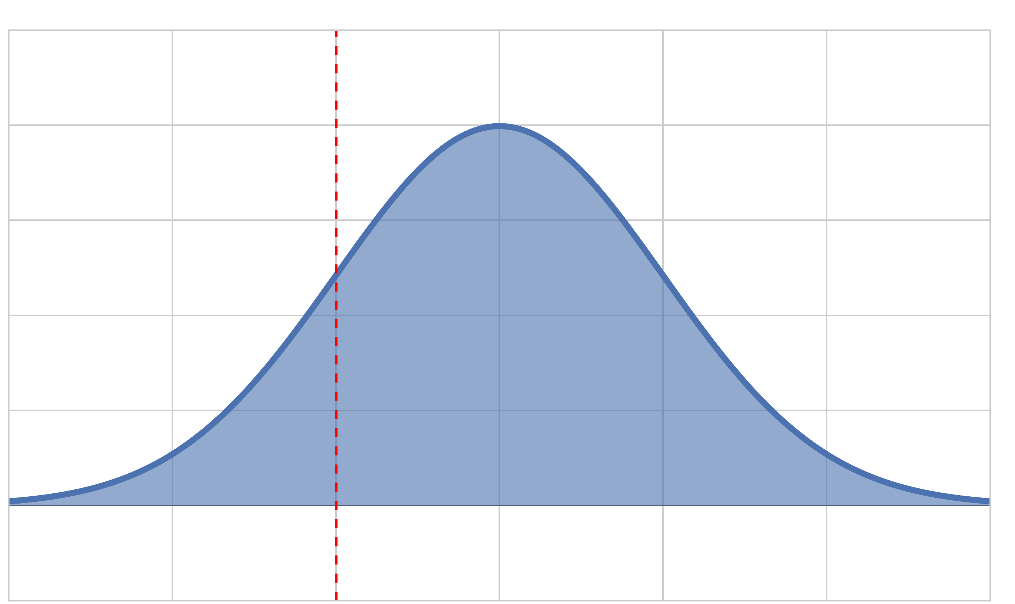
Label design
Estimated price with hindsight
Given information about previous blocks in time, what is our estimate of what the price should be
Q1
Upon finding μ
“Miner Value”
Incentive to accept transaction
Construct a mathematical model for our new label, L
μ
Notes:
- “Miner Value”: Fraction paid per block / Fraction gas as per block
- take out equestion or define everythin

Slide 8
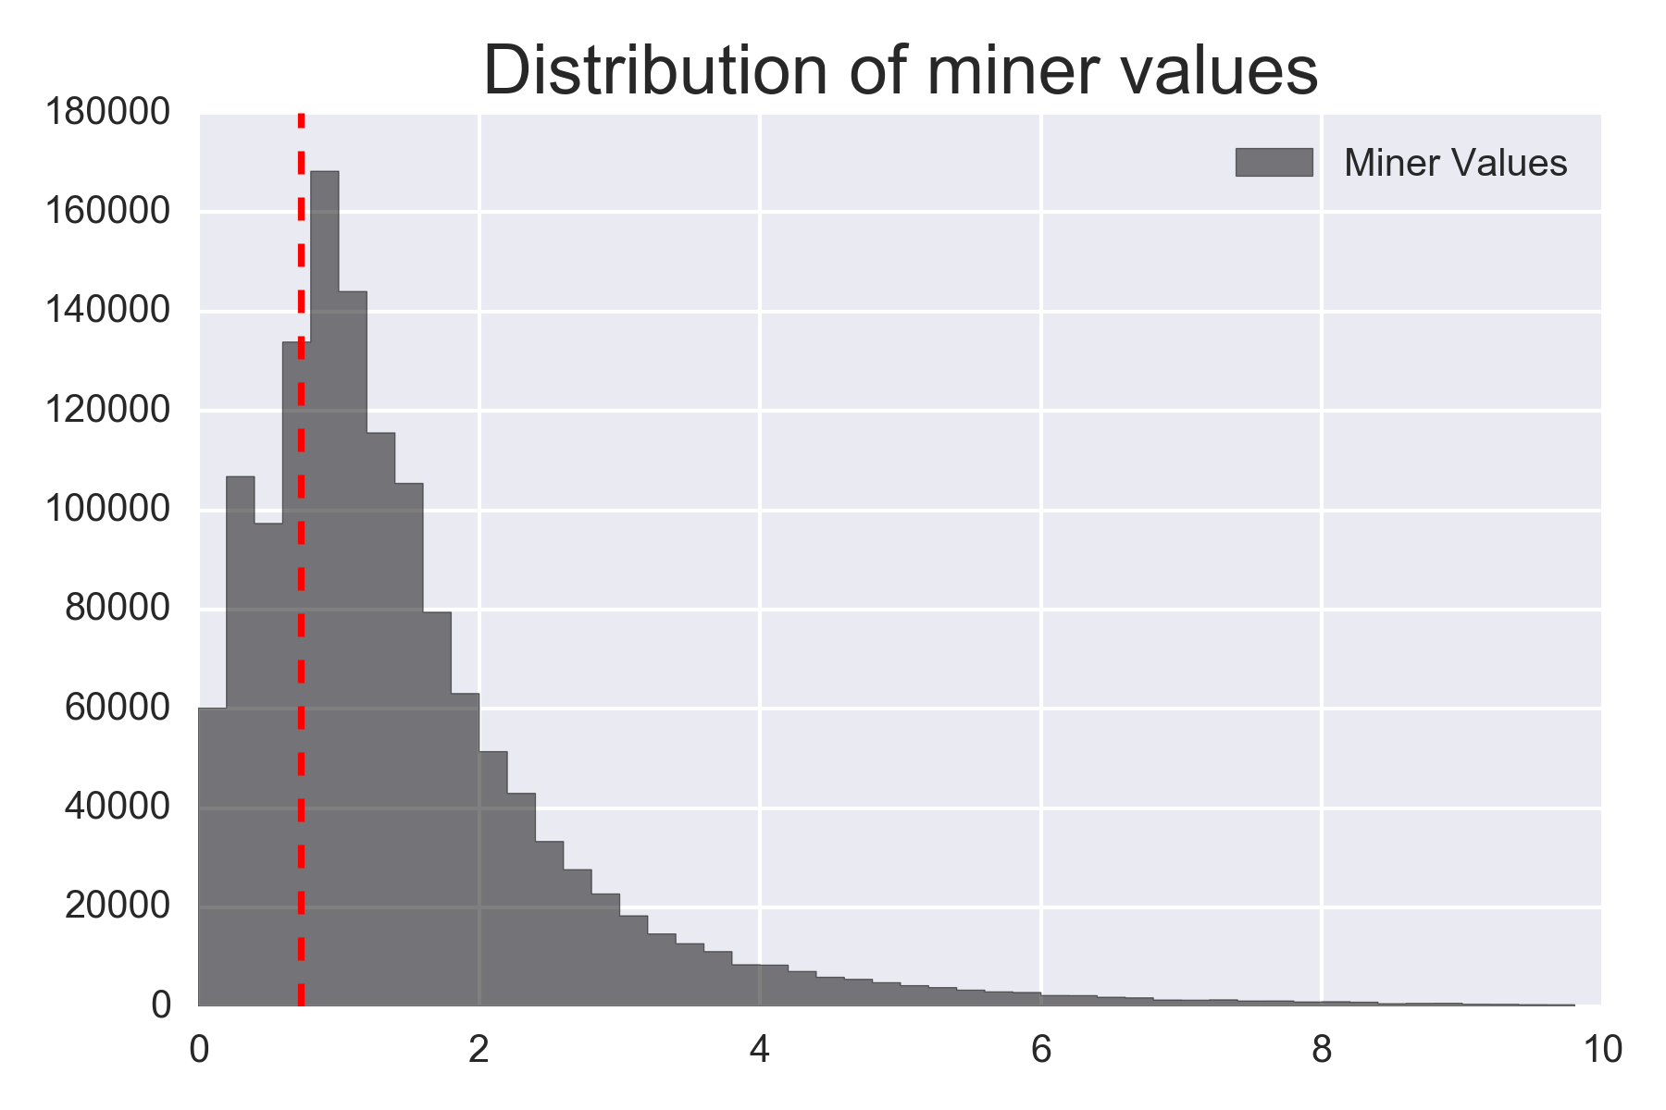
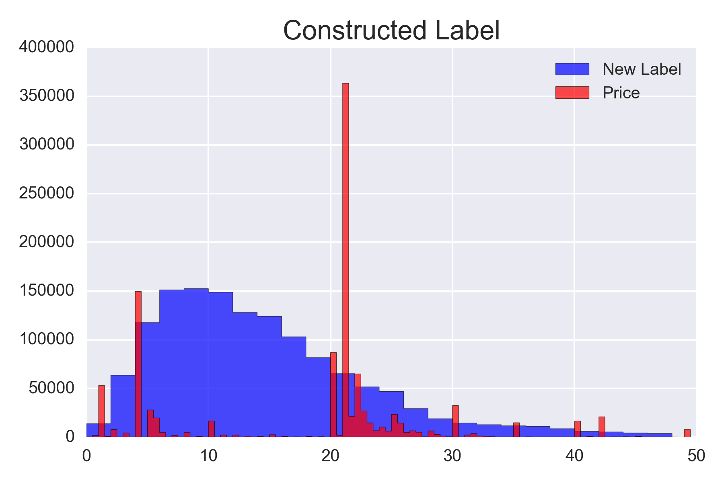
μ = Q1

Slide 9
Feature engineering
Hindsight features:
Averaged values over two time horizons
– 6 previous blocks (~ 1min): current state
– 60 previous blocks (~10min): long-term view
6 block window
60 block window
Block time
Price
Gas used
Tx count
Difficulty
Block time
Price
Gas used
Tx count
Difficulty

Slide 10
Modeling
Linear regression
Decision trees
Boosting
Random forest
– Feature pruning
– Model tuning
– Optimized with grid searching / cross validation
– Model validation
Notes:
– linear relationships were almost non-existent in our dataset, so linear regression was a poor performer
– we tried decision trees and ended up with a random forest regressor
– at first the model was performing nearly perfectly, indicating that there was data leakage or overfitting
– found that there was a lot of multi-collinearity between features and that the feature matrix was rank deficient
– we looked at their variance inflation factors (VIF) and started pruning highly correlated features
– then optimized the model by employing a grid search over all of the hyperparameters
– finally we validated our model with 5-fold cross validation

Slide 11
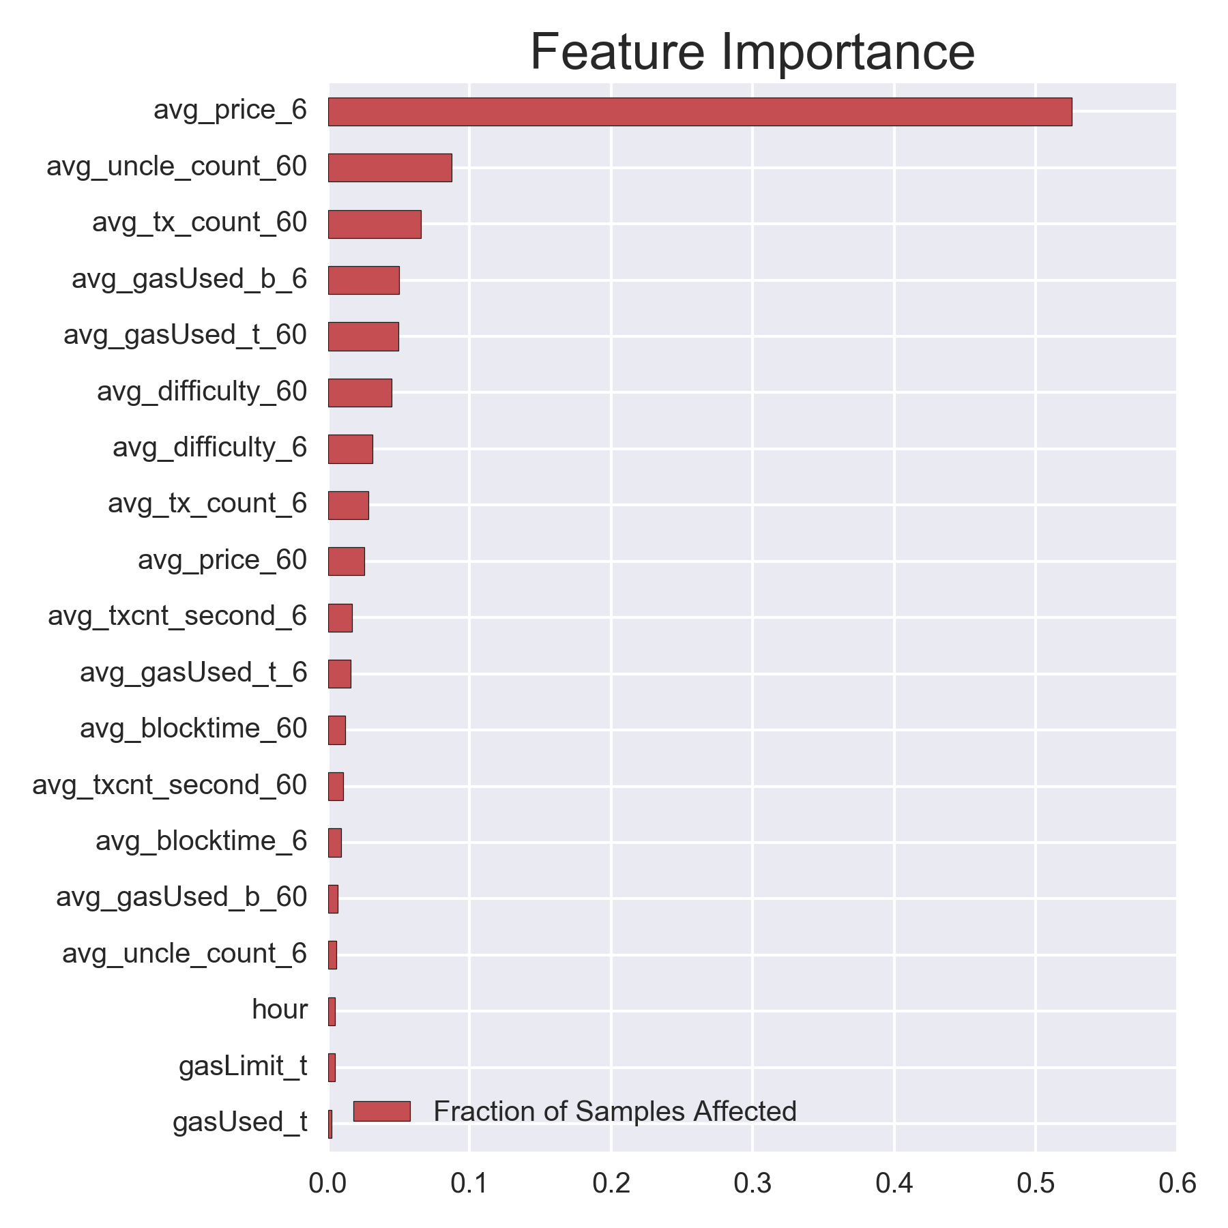

Slide 12



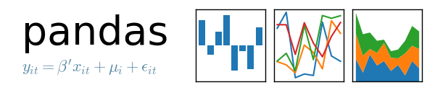

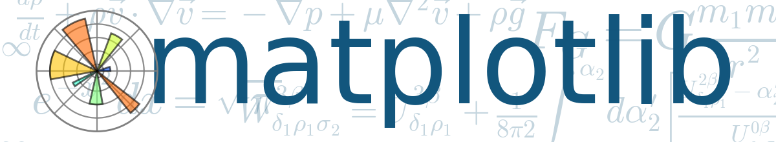

Slide 13
Future
– Utilize entire ethereum blockchain data while also taking in real-time data as it comes in
– Employ neural network model
– Provide real-time gas recommendations

Slide 14
Thank you

